Slide 1
NICE-SLAM: Neural Implicit Scalable Encoding for SLAM
贾彦鹏
Class ：0717
Group：1
Data ：2023.10.16

Slide 2
Outline
一、Introduction
二、Method
三、Experiments
四、Conclusion

Slide 3
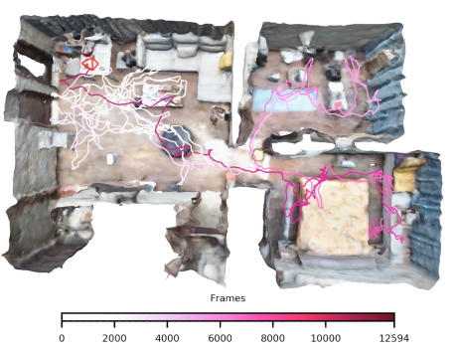
Introduction
SLAM必备属性：
- SLAM系统能够是实时的
- SLAM系统应该有能力对没有观测的区域做出合理的预测
- SLAM系统应该能够扩展到大型场景
- SLAM系统对有噪声或观测缺失的情况具有鲁棒性
传统的稠密视觉SLAM系统 (X) 无法预测
基于学习的SLAM系统 (X) 无法拓展到大场景
iMAP (X) single MLP 不实时
NICE-SLAM (√) 稠密+层次化MLP=NICE
Notes:
Abeba Birhane is an Ethiopian-born cognitive scientist who works at the intersection of complex adaptive systems, machine learning, algorithmic bias, and critical race studies. In 2015, she completed her Master of Science in Cognitive Science and, in 2021, her Ph.D. at the Complex Software Lab in the School of Computer Science at University College Dublin.She has been recognized by VentureBeat as a top innovator in computer vision and named as one of the 100 most influential persons in AI 2023 by TIME magazine.She blogs regularly about embodied cognition and the enactive approach to congnitive science.
You can see this artical in this website.

Slide 4
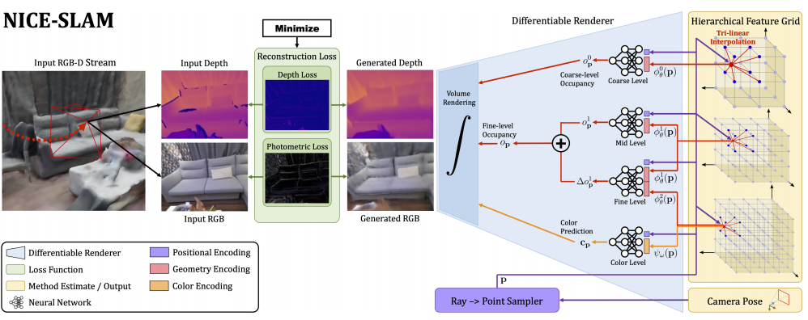
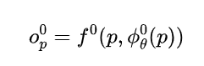
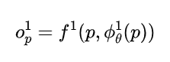
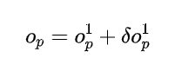
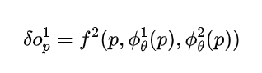
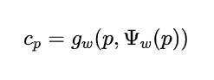
Method
分层场景表示 Hierarchical Scene Representation
粗糙层：目的是捕捉场景的高级几何图形和预测
从粗到精
中间层：目的是重建几何结构
精细层：目的是进行细节优化
颜色层：对颜色信息进行编码，为跟踪提供了额外的信号
Notes:
Descartes was a French philosopher, scientist, and mathematician, widely considered a seminal figure in the emergence of modern philosophy and science.
Descartes has often been called the father of modern philosophy, and is largely seen as responsible for the increased attention given to epistemology in the 17th century.He laid the foundation for 17th-century continental rationalism, later advocated by Spinoza and Leibniz, and was later opposed by the empiricist school of thought consisting of Hobbes, Locke, Berkeley, and Hume.
Descartes' influence in mathematics is equally apparent; the Cartesian coordinate system was named after him. He is credited as the father of analytic geometry—used in the discovery of infinitesimal calculus and analysis. Descartes was also one of the key figures in the Scientific Revolution.

Slide 5
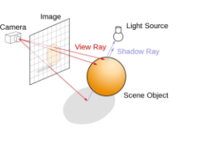
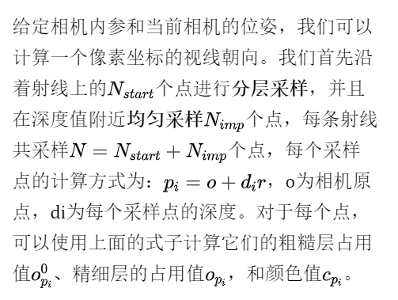
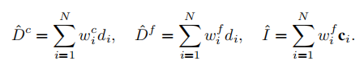
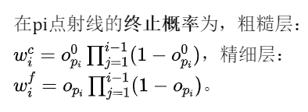
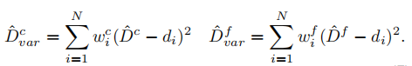
Method
深度和颜色渲染 Depth and Color Rendering
Notes:
Descartes was a French philosopher, scientist, and mathematician, widely considered a seminal figure in the emergence of modern philosophy and science.
Descartes has often been called the father of modern philosophy, and is largely seen as responsible for the increased attention given to epistemology in the 17th century.He laid the foundation for 17th-century continental rationalism, later advocated by Spinoza and Leibniz, and was later opposed by the empiricist school of thought consisting of Hobbes, Locke, Berkeley, and Hume.
Descartes' influence in mathematics is equally apparent; the Cartesian coordinate system was named after him. He is credited as the father of analytic geometry—used in the discovery of infinitesimal calculus and analysis. Descartes was also one of the key figures in the Scientific Revolution.

Slide 6
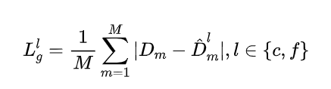
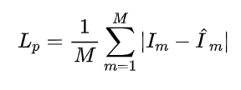
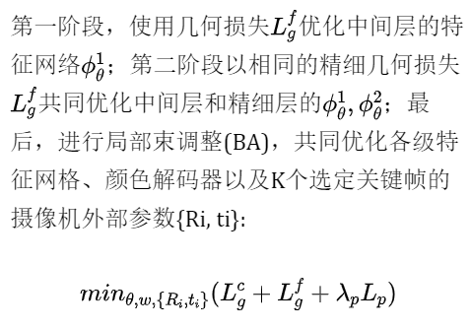
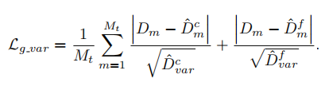
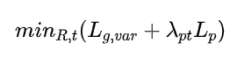
Method
建图和跟踪Mapping and Tracking
Robustness to Dynamic Objects
_{Mapping}
几何损失：
光度损失：
_{Tracking}
改进几何损失：
降低了一些不确定区域的权重
粗糙层的特征网格能够对场景几何图形进行短程预测。当相机移动到以前未观察到的区域时，这种推算出的几何形状为跟踪提供了一个有意义的信号。使其对突然帧丢失或相机快速移动更加鲁棒。
这种多阶段优化方案可以更好地收敛
Notes:
Descartes was a French philosopher, scientist, and mathematician, widely considered a seminal figure in the emergence of modern philosophy and science.
Descartes has often been called the father of modern philosophy, and is largely seen as responsible for the increased attention given to epistemology in the 17th century.He laid the foundation for 17th-century continental rationalism, later advocated by Spinoza and Leibniz, and was later opposed by the empiricist school of thought consisting of Hobbes, Locke, Berkeley, and Hume.
Descartes' influence in mathematics is equally apparent; the Cartesian coordinate system was named after him. He is credited as the father of analytic geometry—used in the discovery of infinitesimal calculus and analysis. Descartes was also one of the key figures in the Scientific Revolution.

Slide 7
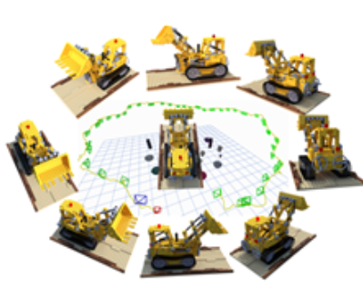
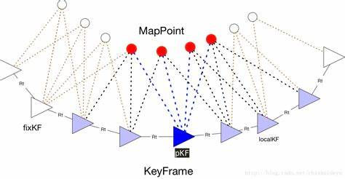
Method
关键帧选取 Keyframe Selection
维护一个全局关键帧列表，根据信息增益逐步添加新的关键帧。然而，与iMAP相比，本文只包含，在优化场景几何图形时与当前帧有视觉重叠的关键帧。这种关键帧选择策略不仅确保了当前视图之外的几何图形保持静态，而且还导致了一个非常有效的优化问题，因为每次只优化必要的参数。
具体步骤如下：
1.随机采样像素，并使用优化的相机姿态反向投影对应的深度。
2.将点云投影到全局关键帧列表中的每个关键帧上。
3.从那些有投影点的关键帧中，随机选择K-2帧，在加上最近的关键帧和当前帧，形成总共K个活动帧。
Notes:
Descartes was a French philosopher, scientist, and mathematician, widely considered a seminal figure in the emergence of modern philosophy and science.
Descartes has often been called the father of modern philosophy, and is largely seen as responsible for the increased attention given to epistemology in the 17th century.He laid the foundation for 17th-century continental rationalism, later advocated by Spinoza and Leibniz, and was later opposed by the empiricist school of thought consisting of Hobbes, Locke, Berkeley, and Hume.
Descartes' influence in mathematics is equally apparent; the Cartesian coordinate system was named after him. He is credited as the father of analytic geometry—used in the discovery of infinitesimal calculus and analysis. Descartes was also one of the key figures in the Scientific Revolution.

Slide 8
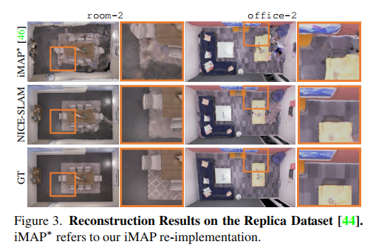
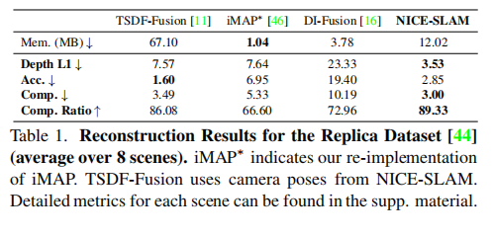
Experiments
度量指标Metrics：
2D：评估来自重建网格和GT真值网格的1000个随机采样的深度图上的L1损3D：遵循iMAP中，精度Accuracy[cm]、完成度Completion[cm]和完成率[<5cm%]。对于相机跟踪的评估，使用ATE RMSE。
Replica数据集
Notes:
Descartes was a French philosopher, scientist, and mathematician, widely considered a seminal figure in the emergence of modern philosophy and science.
Descartes has often been called the father of modern philosophy, and is largely seen as responsible for the increased attention given to epistemology in the 17th century.He laid the foundation for 17th-century continental rationalism, later advocated by Spinoza and Leibniz, and was later opposed by the empiricist school of thought consisting of Hobbes, Locke, Berkeley, and Hume.
Descartes' influence in mathematics is equally apparent; the Cartesian coordinate system was named after him. He is credited as the father of analytic geometry—used in the discovery of infinitesimal calculus and analysis. Descartes was also one of the key figures in the Scientific Revolution.

Slide 9
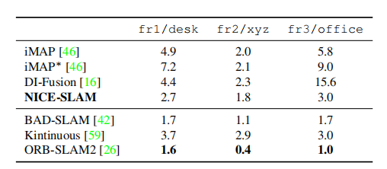
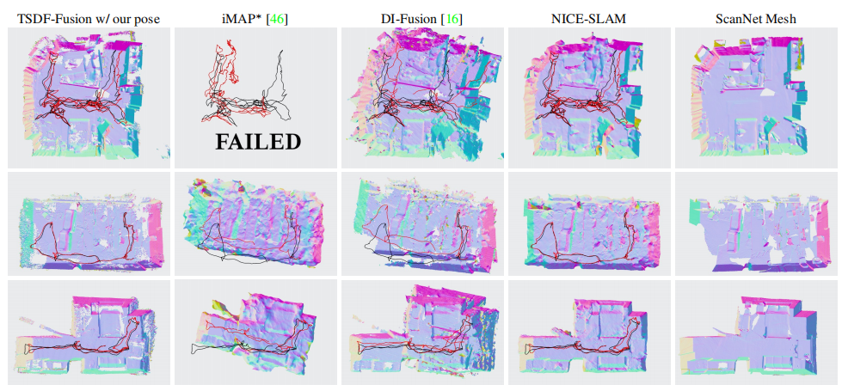
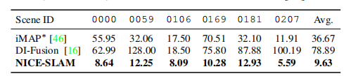
Experiments
TUM RGB-D数据集上
对相机跟踪性能评估
ScanNet数据集
产生了更清晰、更详细的几何形状
在跟踪方面，iMAP∗和DI-Fusion要么完全失败，要么引入了较大的漂移，而提出的方法成功地重建了整个场景。从定量上来说，跟踪结果也明显比DI-Fusion和iMAP∗更准确
Notes:
Descartes was a French philosopher, scientist, and mathematician, widely considered a seminal figure in the emergence of modern philosophy and science.
Descartes has often been called the father of modern philosophy, and is largely seen as responsible for the increased attention given to epistemology in the 17th century.He laid the foundation for 17th-century continental rationalism, later advocated by Spinoza and Leibniz, and was later opposed by the empiricist school of thought consisting of Hobbes, Locke, Berkeley, and Hume.
Descartes' influence in mathematics is equally apparent; the Cartesian coordinate system was named after him. He is credited as the father of analytic geometry—used in the discovery of infinitesimal calculus and analysis. Descartes was also one of the key figures in the Scientific Revolution.

Slide 10
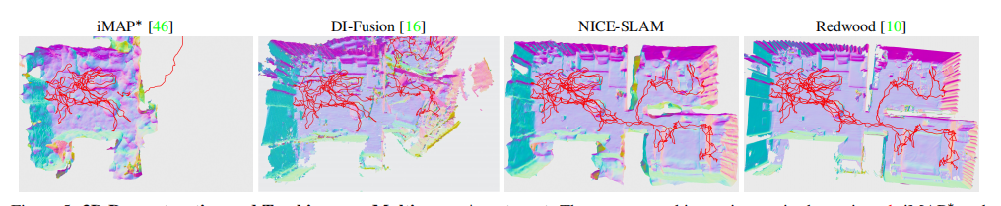
Experiments
在更大场景数据集上的评估
了评估提出的方法的可扩展性，在一个有多个房间的大公寓中捕获了一个序列。下图显示了使用NICE-SLAM、DI-Fusion和iMAP*获得的重建结果。作为参考，还展示了在Open3D中使用离线工具Redwoud的三维重建。可以看到，NICE-SLAM与离线方法具有相似的结果，而iMAP∗和DI-FusioN无法重建整个序列。
Notes:
Descartes was a French philosopher, scientist, and mathematician, widely considered a seminal figure in the emergence of modern philosophy and science.
Descartes has often been called the father of modern philosophy, and is largely seen as responsible for the increased attention given to epistemology in the 17th century.He laid the foundation for 17th-century continental rationalism, later advocated by Spinoza and Leibniz, and was later opposed by the empiricist school of thought consisting of Hobbes, Locke, Berkeley, and Hume.
Descartes' influence in mathematics is equally apparent; the Cartesian coordinate system was named after him. He is credited as the father of analytic geometry—used in the discovery of infinitesimal calculus and analysis. Descartes was also one of the key figures in the Scientific Revolution.

Slide 11
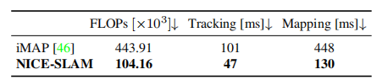
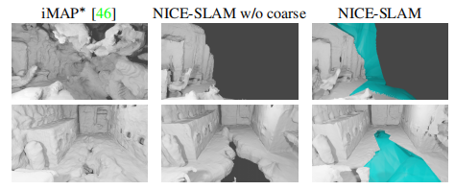
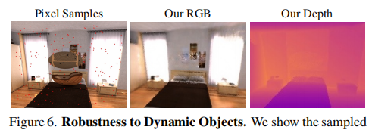
Experiments
性能分析
预测的填充区域
一个3D点的颜色和占用率/体积密度所需的浮点操作(FLOPs)的数量
对动态物体的鲁棒性
Notes:
Descartes was a French philosopher, scientist, and mathematician, widely considered a seminal figure in the emergence of modern philosophy and science.
Descartes has often been called the father of modern philosophy, and is largely seen as responsible for the increased attention given to epistemology in the 17th century.He laid the foundation for 17th-century continental rationalism, later advocated by Spinoza and Leibniz, and was later opposed by the empiricist school of thought consisting of Hobbes, Locke, Berkeley, and Hume.
Descartes' influence in mathematics is equally apparent; the Cartesian coordinate system was named after him. He is credited as the father of analytic geometry—used in the discovery of infinitesimal calculus and analysis. Descartes was also one of the key figures in the Scientific Revolution.

Slide 12
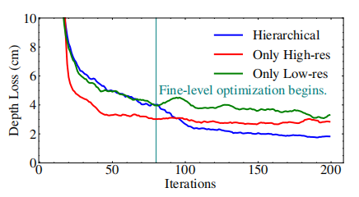
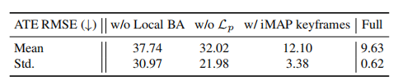
Experiments
消融实验
分层结构Hierarchical Architecture
消融实验Ablation Study
局部光束平差Local BA
颜色表示Color Representation
关键帧选取KeyFrame Selection：防止iMAP简单的多层感知机忘记了之前的几何形状
Notes:
Descartes was a French philosopher, scientist, and mathematician, widely considered a seminal figure in the emergence of modern philosophy and science.
Descartes has often been called the father of modern philosophy, and is largely seen as responsible for the increased attention given to epistemology in the 17th century.He laid the foundation for 17th-century continental rationalism, later advocated by Spinoza and Leibniz, and was later opposed by the empiricist school of thought consisting of Hobbes, Locke, Berkeley, and Hume.
Descartes' influence in mathematics is equally apparent; the Cartesian coordinate system was named after him. He is credited as the father of analytic geometry—used in the discovery of infinitesimal calculus and analysis. Descartes was also one of the key figures in the Scientific Revolution.

Slide 13
Conclusion
结论及局限性
结论：牛逼
局限性：该方法的预测能力仅限于粗糙表示的尺度。此外，目前还没有执行闭环检测，未来也可以考虑加入闭环检测，这可能会有更好的效果。我感觉将NeRF引入SLAM，其实是更偏重于“建图”模块，文中的实验也提到了，与经典的一些注重于定位SLAM框架相比，跟踪误差还是有待提高的。
Notes:
Descartes was a French philosopher, scientist, and mathematician, widely considered a seminal figure in the emergence of modern philosophy and science.
Descartes has often been called the father of modern philosophy, and is largely seen as responsible for the increased attention given to epistemology in the 17th century.He laid the foundation for 17th-century continental rationalism, later advocated by Spinoza and Leibniz, and was later opposed by the empiricist school of thought consisting of Hobbes, Locke, Berkeley, and Hume.
Descartes' influence in mathematics is equally apparent; the Cartesian coordinate system was named after him. He is credited as the father of analytic geometry—used in the discovery of infinitesimal calculus and analysis. Descartes was also one of the key figures in the Scientific Revolution.

Slide 14
Thanks For Listening
Class ：0717
Group：1
Data ：2023.10.16

